Slide 1

Welcome to Zesty,
Your go-to cooking companion!
Notes:
Intro - Katie

Slide 2
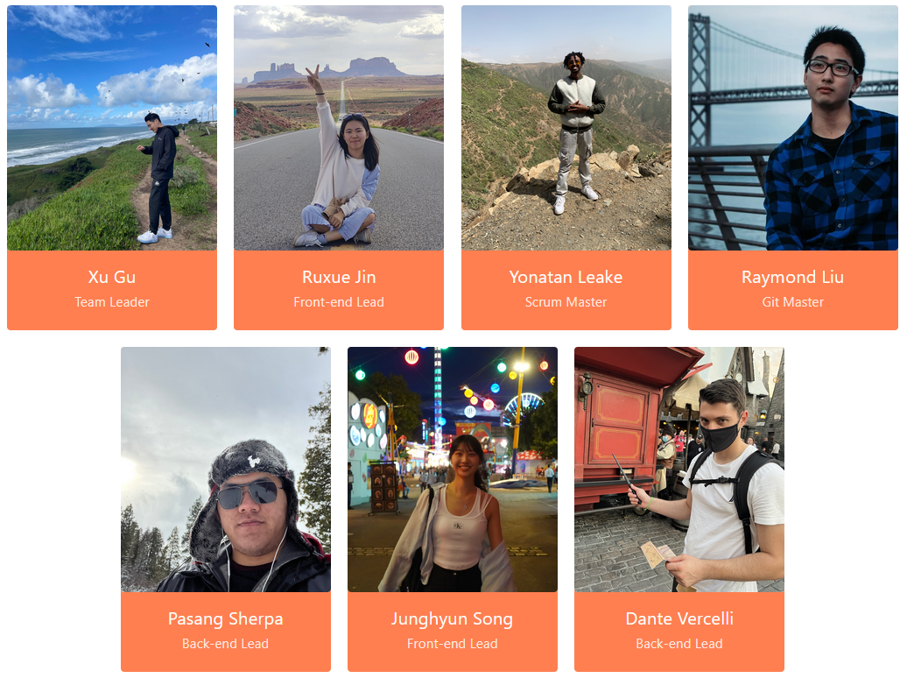
Meet our Team!

Slide 3




What is ?
User-friendly Recipe Sharing Platform
I don’t know which ingredients I have
I wonder what I can cook with the ingredients I have
I need a recipe platform just for me

Slide 4
What ingredients
the users have
Intuitive
&
Easy to use

Slide 5
Zesty - Exploring Key Features
Discover Recipes
Rating and Comments for Recipes
Favorite Recipes
Smart Recipe Creation
Personalized Pantry
Tailored Recipe Suggestions
Notes:
Lets show zesty and all of its features in these next slides 1-3 Raymond 4-6 RUxue

Slide 6
Discover Recipes
Easily search Zesty's wide variety of available recipes.
Notes:
Show off searching for recipes

Slide 7
Rating and Comments for Recipes
Share your feedback by rating and commenting on recipes.
Notes:
Show rating and comment feature

Slide 8
Favorite Recipes
Save your favorite recipes directly to your profile for convenient access.
Notes:
Show favorites feature

Slide 9
Smart Recipe Creation
Share your own recipes with a guided template, and optional AI assistance.
Notes:
Share recipe creation with ai assistance

Slide 10
Personalized Pantry
Seamlessly build your own virtual pantry by adding ingredients manually or leveraging cutting-edge AI technology.
Say goodbye to last-minute grocery runs! Zesty intelligently identifies the missing ingredients for recipes you are exploring
Notes:
Share the pantry and its features

Slide 11
Tailored Recipe Suggestions
Enjoy a curated selection of recipes tailored to the ingredients in your pantry, ensuring you make the most of what you have.

Slide 12
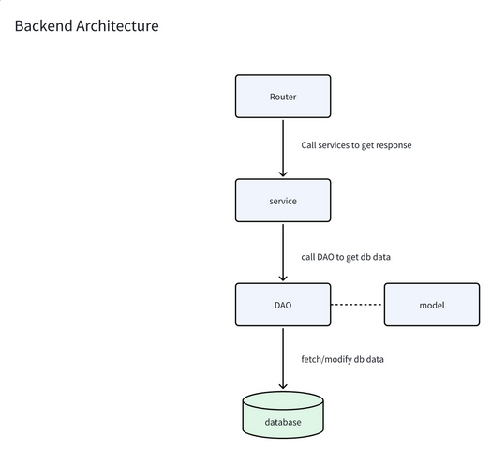
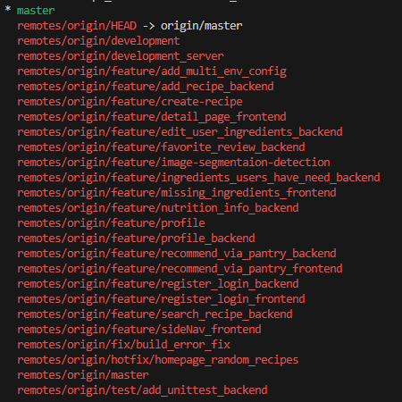
Source Code Structure and Management
Notes:
Dante

Slide 13
Task Management - Notion
We used Notion to track and assign tasks for our team.
API documentation facilitating concurrent development for frontend and backend
Development guide - setting expectations for feature implementation
Notes:
Yonatan

Slide 14
Thank you!
https://nexas.me
Notes:
https://nexas.me

